Slide 1
Finetuning of the different models on the quora(question-answer)dataset to evaluate the model performace using BLEU scores
By Piyush joshi

Slide 2
Using of the GPT-2 model finetuned on quora (question-answer) dataset
The aim of this code is to fine-tune the GPT-2 model on the Quora question-answer dataset. This involves several key steps:
Text Preprocessing: Cleaning and normalizing the text data by removing stop words, stemming, and lemmatizing to ensure consistency and better model performance.
Tokenization: Converting the cleaned text into tokenized sequences that the GPT-2 model can process, including padding sequences to a uniform length.
Model Training: Fine-tuning the pre-trained GPT-2 model on the tokenized dataset to adapt it specifically for generating answers to questions based on the Quora dataset.
Evaluation: Setting up the necessary training parameters and evaluation strategy to monitor the model’s performance during training.
Model Saving: Saving the fine-tuned model to a specified directory for future use.

Slide 3
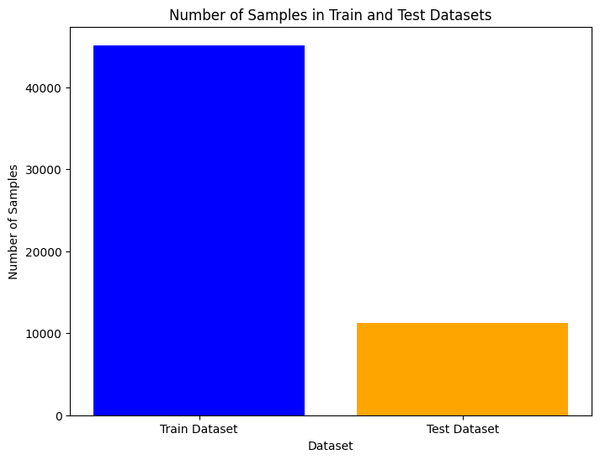
Figure – 1 Splitting of the dataset

Slide 4
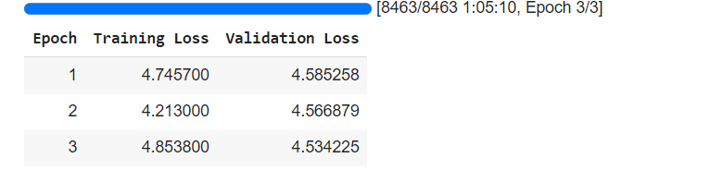
Finetuning of the Gpt-2 model on the test dataset
Figure-2 Training and the validation loss

Slide 5
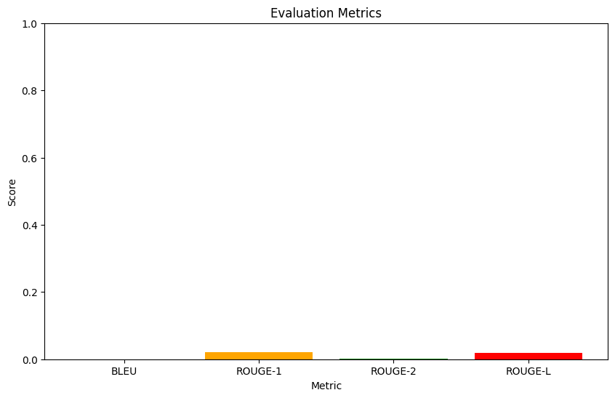
GPT-2 evaluation metrics on the test dataset
Figure – 3 Bleu score is very less hence very less as less no of test dataset rows are selected in this,bleu': 1.5401423320497265e-07,1000 rows of the test dataset is selected because collab kernel is crashing.

Slide 6
Evaluating a Fine-Tuned GPT-2 Model on a Subset of Training Data and test data
Fine-tuned GPT-2 model is evaluated on a subset of training data and to the test dataset. The model is loaded from a specified directory, and a custom trainer is set up to handle evaluation on the CPU. A small subset of the training dataset is selected for evaluation. The model generates predictions for this subset, and these predictions are compared to the actual answers in the dataset. The predictions and references are decoded into readable text and printed to assess the model's performance.

Slide 7
OUTCOME
1.Due to the kernel crashing the model is not fully trained on the test dataset but giving insights is of 1000 rows the results may be good if we train for whole of the test dataset in this case.
2.The model is not giving better answers in case of the Evaluating a Fine-Tuned GPT-2 Model on a Subset of Training Data and test data.
3.Learnings were the model can give better evaluation metrics and ai assisted model when trained on whole test dataset but due to the crashing of kernel it is not possible to this.
4.The model can have both the pretrained and the fine-tuned knowledge for this and can lead to better ai assisted system if trained on whole dataset.

Slide 8
Evaluating T5 Model on Quora Question-Answer Dataset Using BLEU Score for Generated Answers
.
1.This code evaluates the performance of the T5 model (google-t5/t5-large) on a subset of the Quora Question Answer dataset. It begins by downloading necessary NLTK resources and defining functions for text preprocessing, such as tokenization, stemming, and lemmatization. The dataset is then loaded from "toughdata/quora-question-answer-dataset," and a subset of 5000 rows is selected for analysis.
2.Both questions and answers in the dataset undergo preprocessing to standardize the text, including converting it to lowercase, removing non-alphabetic tokens, and applying stemming or lemmatization. The T5 model and tokenizer are initialized, and the preprocessed questions are fed into the model using the pipeline API to generate answers. These generated answers are also preprocessed.
3.The BLEU score, a metric for evaluating the quality of generated text, is calculated to measure how closely the generated answers match the reference answers in the dataset. This calculation is performed in batches, and the scores are stored for plotting. The BLEU scores are then plotted to visualize the model's performance across the subset of 5000 samples.
Finally, the overall performance of the model on the entire subset is assessed by computing and printing the final BLEU score. This process provides insight into how well the T5 model can generate answers that are similar to the reference answers in the dataset.

Slide 9
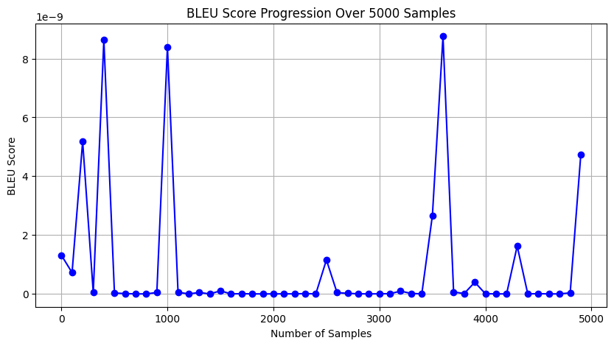
Figure- 4 BLEU score for T5 model for 5000 rows

Slide 10
Evaluating BART Model on Quora Question-Answer Dataset Using BLEU Score for Generated Answers
1.This code evaluates the performance of the BART model on a subset of the Quora Question Answer dataset. It begins by downloading necessary NLTK resources and defining functions for text preprocessing, such as tokenization, stemming, and lemmatization. The dataset is then loaded from "toughdata/quora-question-answer-dataset," and a subset of 5000 rows is selected for analysis.
2.Both questions and answers in the dataset undergo preprocessing to standardize the text, including converting it to lowercase, removing non-alphabetic tokens, and applying stemming or lemmatization. The T5 model and tokenizer are initialized, and the preprocessed questions are fed into the model using the pipeline API to generate answers. These generated answers are also preprocessed.
3.The BLEU score, a metric for evaluating the quality of generated text, is calculated to measure how closely the generated answers match the reference answers in the dataset. This calculation is performed in batches, and the scores are stored for plotting. The BLEU scores are then plotted to visualize the model's performance across the subset of 5000 samples.
Finally, the overall performance of the model on the entire subset is assessed by computing and printing the final BLEU score. This process provides insight into how well the T5 model can generate answers that are similar to the reference answers in the dataset.

Slide 11
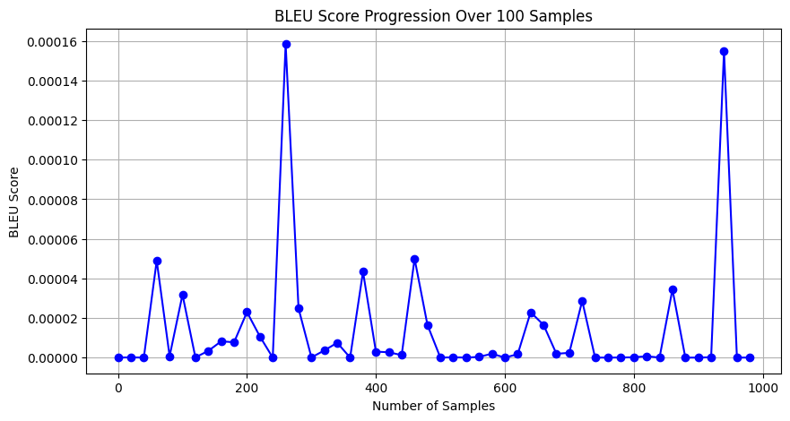
Figure- 5 BELU score for the BART MODEL for 1000 rows

Slide 12
Evaluating BART Model on Quora Question-Answer Dataset Using BLEU Score for Generated Answers
1.This code evaluates the performance of the GPT-2 model on a subset of the Quora Question Answer dataset. It begins by downloading necessary NLTK resources and defining functions for text preprocessing, such as tokenization, stemming, and lemmatization. The dataset is then loaded from "toughdata/quora-question-answer-dataset," and a subset of 5000 rows is selected for analysis.
2.Both questions and answers in the dataset undergo preprocessing to standardize the text, including converting it to lowercase, removing non-alphabetic tokens, and applying stemming or lemmatization. The T5 model and tokenizer are initialized, and the preprocessed questions are fed into the model using the pipeline API to generate answers. These generated answers are also preprocessed.
3.The BLEU score, a metric for evaluating the quality of generated text, is calculated to measure how closely the generated answers match the reference answers in the dataset. This calculation is performed in batches, and the scores are stored for plotting. The BLEU scores are then plotted to visualize the model's performance across the subset of 5000 samples.
Finally, the overall performance of the model on the entire subset is assessed by computing and printing the final BLEU score. This process provides insight into how well the T5 model can generate answers that are similar to the reference answers in the dataset.

Slide 13
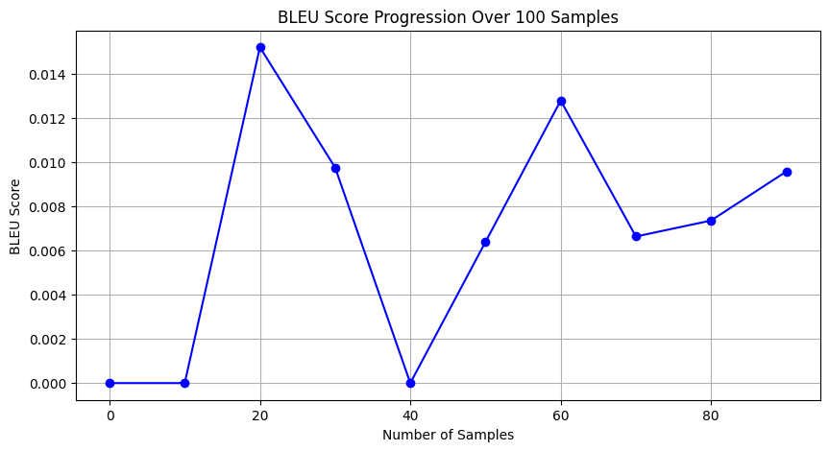
Figure-6 BELU score for the GPT-2 Model

Slide 14
OUTCOME
1.The evaluation of the T5, BART, and GPT-2 models on a subset of the Quora Question Answer dataset demonstrates the capabilities and performance of each model in generating answers that closely match the reference answers. The preprocessing steps ensured the standardization of text, which is crucial for accurate model evaluation. By employing the BLEU score as a metric, the analysis provided a clear quantification of how well each model performed in terms of generating relevant and coherent answers.
2.The visual representation of BLEU scores across 5000,1000,100 samples offered an intuitive understanding of the models' performance trends and consistency. The final computed BLEU score for each model highlighted their overall effectiveness in handling the question-answering task.
3.In conclusion, this evaluation process not only showcased the strengths and potential areas of improvement for the T5, BART, and GPT-2 models but also underscored the importance of thorough preprocessing and robust evaluation metrics in assessing the quality of generated text. The insights gained from this analysis can inform future improvements and adaptations of these models for similar natural language processing tasks.

Slide 15
Result
1.The GPT-2 model finetuned on the training dataset can be used for the evaluation by using the test dataset but it cannot be used for small test dataset.
2.Take the three models BART,T5 and GPT-2 model is used to produce the answers of the generated questions of the quora(question-answer)dataset and comparing with the actual answers in this but it is giving good small evaluation insights but due to limited resources can generated the full insights needs gpu for this.
3.Learning is this without finetuning the model is generating some bleu score which is giving some insights that the pretrained model has some knowledge of the dataset without finetuning.
4.We can compare the models that which models can show the better bleu score at the number of the rows.

